Slide 1
Crystal lake’s mansion
Producer: Jermo
Lead Artist & Scrum: Stanley
UX: Jorrit & Stefan
Lead Programmer: Daniel

Slide 2
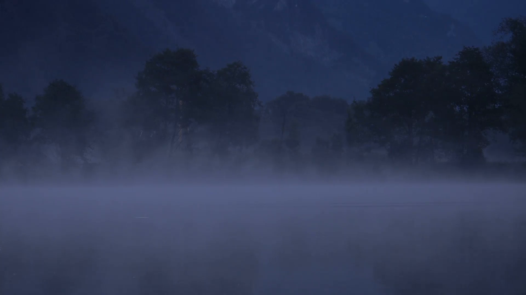
Inhoud
General Progress
U.X.
Programming
Art
Reflectie
Questions

Slide 3
General Progress
Op schema met onderdelen
Implementen loop achter

Slide 4
U.X.
Shaders
Sound
UI
Lighting
Particles

Slide 5
Programming
Basic interaction
Monster AI
Player movement
A*
Illusion of learning AI

Slide 6
Art
Rooms
Enemy
Player
Props

Slide 7
Reflectie
The good
The bad
The monsters

Slide 8
Any questions?

Slide 9
Extra

